Slide 1

Adding value to Marula: Modelling of the extraction of valuable compounds from Sclerocarya birrea
By Trishen Reddy
Department of Engineering & Technology
Supervisor: Prof. Tumisang Seodigeng

Slide 2
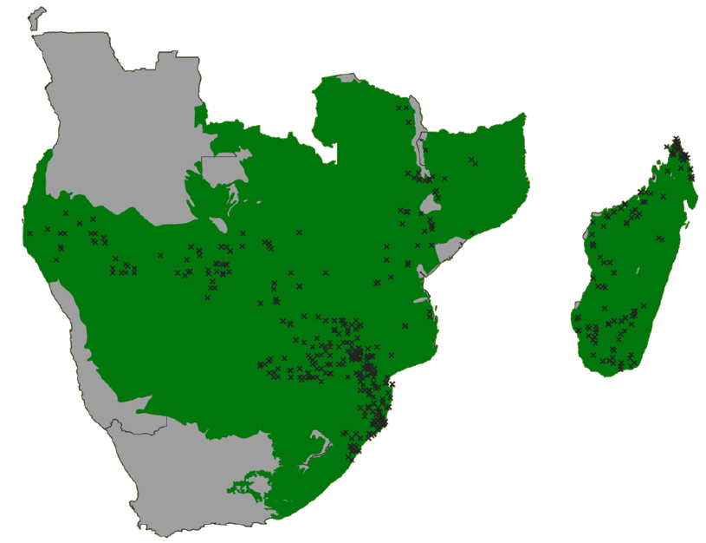
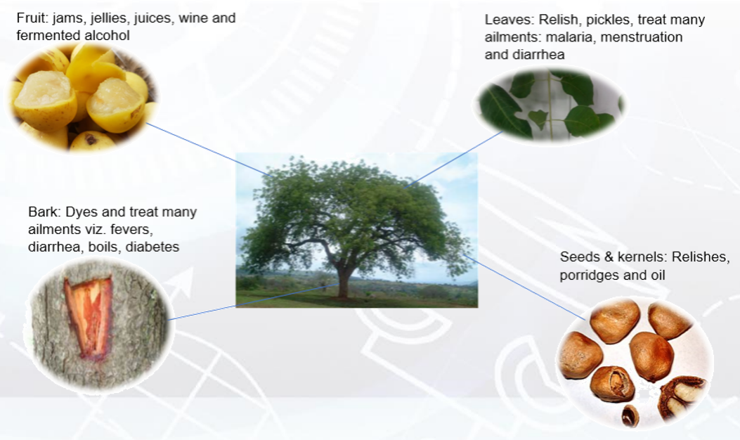
About marula:
Common names: marula (English); maroela (Afrikaans); morula (Tswana); and umGanu (isiZulu)

Slide 3
Problem Statement
No empirical studies or mathematical models have been developed on the extraction of marula oil.
Aim
The aim of the study is to determine suitable mathematical and empirical models for the extraction of marula kernel oil.
Objectives
Application of modelling to determine the yield of marula oil using experimental data of supercritical fluid extraction process from literature.
Application of mathematical modelling to determine the oil yield of Sclerocarya birrea kernel oil using response surface methodology.

Slide 4
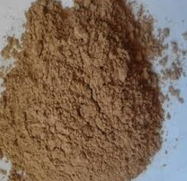
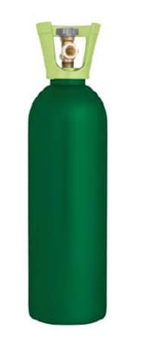

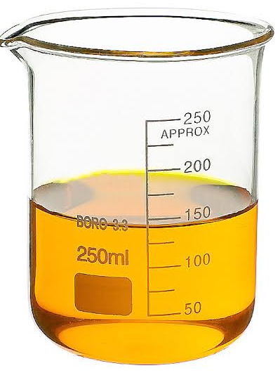
Experimental data from literature
Supercritical Fluid Extraction Process
Crushed marula kernels (solute)
Experimental run number | Temperature (°C) | Pressure (bar) | Observed Response ( g oil/L CO₂)
1 | 40 | 250 | 5.808
2 | 60 | 250 | 3.542
3 | 75 | 250 | 1.851
4 | 40 | 350 | 8.135
5 | 60 | 350 | 7.853
6 | 75 | 350 | 7.757
7 | 40 | 450 | 8.483
8 | 60 | 450 | 9.221
9 | 75 | 450 | 8.93
T
P
CO₂
Solvent
Oven
Marula Oil

Slide 5
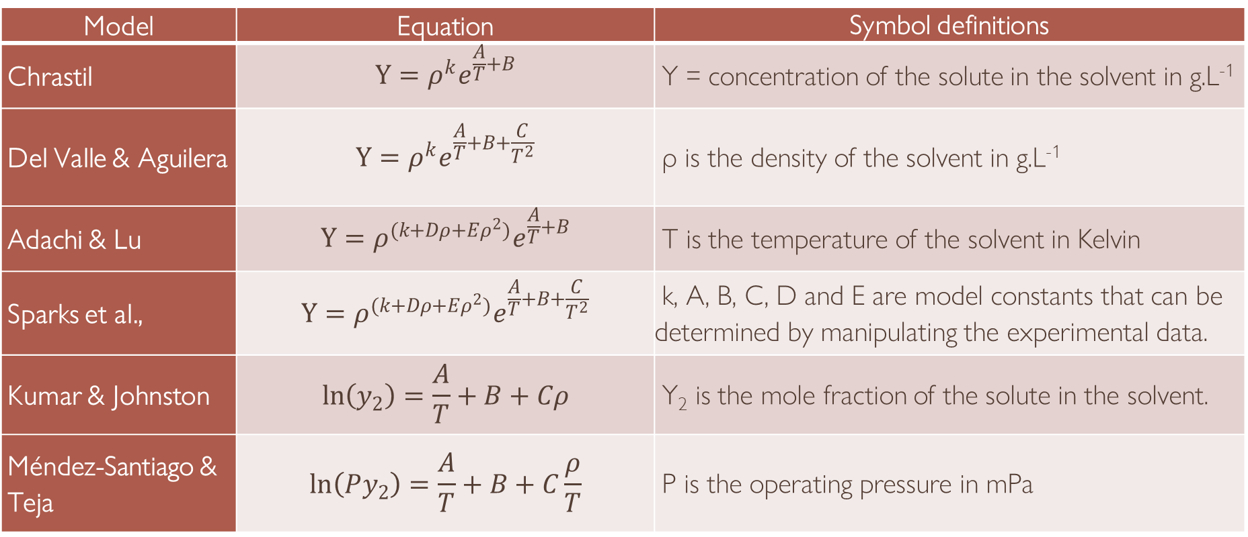
Empirical Modelling
Model | Equation | Symbol definitions
Chrastil | $$Y=ρ^{k}e^{\frac{A}{T}+B}$$ | Y = concentration of the solute in the solvent in g.L⁻¹
Del Valle & Aguilera | $$Y=ρ^{k}e^{\frac{A}{T}+B+\frac{C}{T^{2}}}$$ | ρ is the density of the solvent in g.L⁻¹
Adachi & Lu | $$Y=ρ^{(k+Dρ+Eρ^{2})}e^{\frac{A}{T}+B}$$ | T is the temperature of the solvent in Kelvin
Sparks et al., | $$Y=ρ^{(k+Dρ+Eρ^{2})}e^{\frac{A}{T}+B+\frac{C}{T^{2}}}$$ | k, A, B, C, D and E are model constants that can be determined by manipulating the experimental data.
Kumar & Johnston | $$\ln\left(y_{2}\right)=\frac{A}{T}+B+Cρ$$ | Y₂ is the mole fraction of the solute in the solvent.
Méndez-Santiago & Teja | $$\ln\left(Py_{2}\right)=\frac{A}{T}+B+C\frac{ρ}{T}$$ | P is the operating pressure in mPa

Slide 6
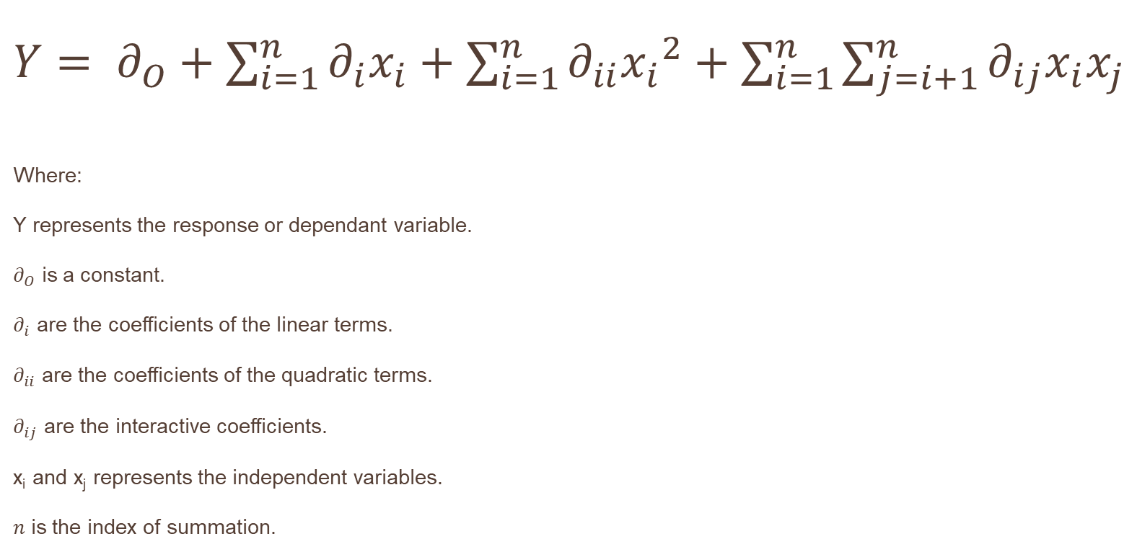
Mathematical Modelling
$Y= ∂_{O}+\sum_{i=1}^{n}{∂_{i}x_{i}}+\sum_{i=1}^{n}{∂_{ii}{x_{i}}^{2}}+\sum_{i=1}^{n}{\sum_{j=i+1}^{n}{∂_{ij}x_{i}x_{j}}}$
Where:
Y represents the response or dependant variable.
$∂_{O}$ is a constant.
$∂_{i}$ are the coefficients of the linear terms.
$∂_{ii}$ are the coefficients of the quadratic terms.
$∂_{ij}$ are the interactive coefficients.
x_{i} and x_{j} represents the independent variables.
$n$ is the index of summation.

Slide 7
The importance of modelling

Slide 8

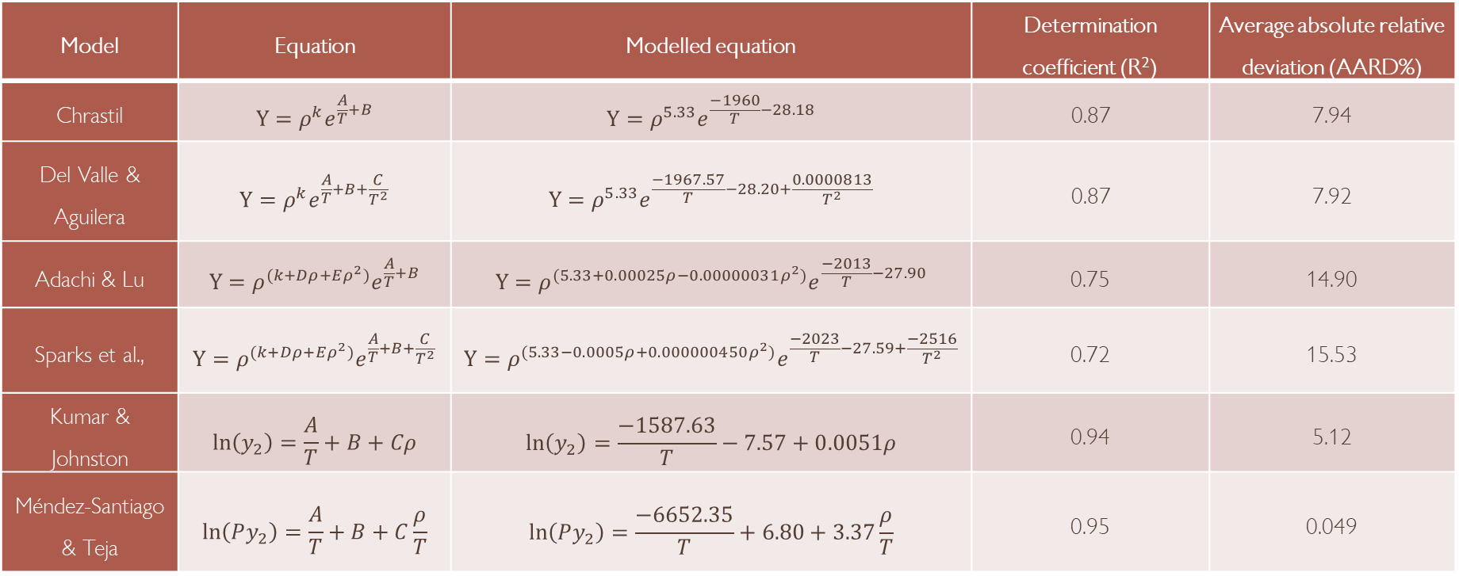
Results: Empirical Modelling
Model | Equation | Modelled equation | Determination coefficient (R²) | Average absolute relative deviation (AARD%)
Chrastil | $$Y=ρ^{k}e^{\frac{A}{T}+B}$$ | $$Y=ρ^{5.33}e^{\frac{−1960}{T}−28.18}$$ | 0.87 | 7.94
Del Valle & Aguilera | $$Y=ρ^{k}e^{\frac{A}{T}+B+\frac{C}{T^{2}}}$$ | $$Y=ρ^{5.33}e^{\frac{−1967.57}{T}−28.20+\frac{0.0000813}{T^{2}}}$$ | 0.87 | 7.92
Adachi & Lu | $$Y=ρ^{(k+Dρ+Eρ^{2})}e^{\frac{A}{T}+B}$$ | $$Y=ρ^{(5.33+0.00025ρ−0.00000031ρ^{2})}e^{\frac{−2013}{T}−27.90}$$ | 0.75 | 14.90
Sparks et al., | $$Y=ρ^{(k+Dρ+Eρ^{2})}e^{\frac{A}{T}+B+\frac{C}{T^{2}}}$$ | $$Y=ρ^{(5.33−0.0005ρ+0.000000450ρ^{2})}e^{\frac{−2023}{T}−27.59+\frac{−2516}{T^{2}}}$$ | 0.72 | 15.53
Kumar & Johnston | $$\ln\left(y_{2}\right)=\frac{A}{T}+B+Cρ$$ | $$\ln\left(y_{2}\right)=\frac{−1587.63}{T}−7.57+0.0051ρ$$ | 0.94 | 5.12
Méndez-Santiago & Teja | $$\ln\left(Py_{2}\right)=\frac{A}{T}+B+C\frac{ρ}{T}$$ | $$\ln\left(Py_{2}\right)=\frac{−6652.35}{T}+6.80+3.37\frac{ρ}{T}$$ | 0.95 | 0.049
High R² =
Low AARD% =
High AARD% =
Low R² =

Slide 9
Results: Empirical Modelling
 |  |  |  | Predicted values (g oil/L CO₂)
Temperature (°C) | Pressure (bar) | Density (g/L) | Experimental values (g oil/L CO₂) | Chrastil | DVA | AL | Sparks et al.,
40 | 250 | 880 | 5.808 | 5.376 | 5.3694 | 5.384 | 5.053
60 | 250 | 787 | 3.542 | 4.317 | 4.3153 | 5.157 | 3.487
75 | 250 | 712 | 1.851 | 3.262 | 3.2624 | 4.354 | 2.429
40 | 350 | 935 | 8.135 | 7.426 | 7.4193 | 6.609 | 7.921
60 | 350 | 863 | 7.853 | 7.055 | 7.0560 | 7.380 | 6.502
75 | 350 | 808 | 7.757 | 6.401 | 6.4051 | 7.442 | 5.395
40 | 450 | 975 | 8.483 | 9.283 | 9.2768 | 7.512 | 11.002
60 | 450 | 913 | 9.221 | 9.525 | 9.5284 | 8.993 | 9.780
75 | 450 | 867 | 8.930 | 9.3177 | 9.3278 | 9.738 | 8.743

Slide 10
Results: Empirical Modelling
 |  |  |  | Predicted values (Mole fraction)
Temperature (°C) | Pressure (bar) | Density (g/L) | Experimental values (Mole fraction) | Kumar and Johnston | Méndez-Santiago and Teja
40 | 250 | 880 | 0.000283 | 0.000281 | 0.000276
60 | 250 | 787 | 0.000220 | 0.000238 | 0.000218
75 | 250 | 712 | 0.000127 | 0.000199 | 0.000177
40 | 350 | 935 | 0.000397 | 0.000372 | 0.000356
60 | 350 | 863 | 0.000383 | 0.000350 | 0.000336
75 | 350 | 808 | 0.000379 | 0.000325 | 0.000321
40 | 450 | 975 | 0.000414 | 0.000455 | 0.000426
60 | 450 | 913 | 0.000450 | 0.000451 | 0.000434
75 | 450 | 867 | 0.000436 | 0.000438 | 0.000441

Slide 11
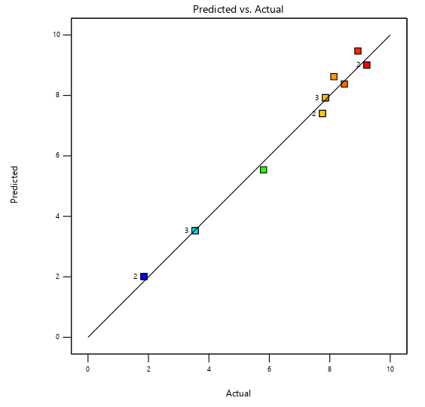
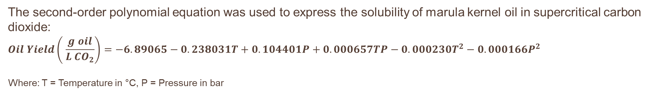
Results: Mathematical modelling
The second-order polynomial equation was used to express the solubility of marula kernel oil in supercritical carbon dioxide:
$$Oil Yield\left( \frac{g oil}{L {CO}_{2}}\right)=−6.89065−0.238031T+0.104401P+0.000657TP−0.000230T^{2}−0.000166P^{2}$$
Where: T = Temperature in °C, P = Pressure in bar
Experimental run number | Temperature (°C) | Pressure (bar) | Observed response (g oil/L CO₂) | Predicted response (g oil/L CO₂)
1 | 40 | 250 | 5.808 | 5.515
2 | 60 | 250 | 3.5415 | 3.580
3 | 75 | 250 | 1.8512 | 2.007
4 | 40 | 350 | 8.1345 | 8.623
5 | 60 | 350 | 7.8533 | 8.002
6 | 75 | 350 | 7.7568 | 7.415
7 | 40 | 450 | 8.4825 | 8.412
8 | 60 | 450 | 9.2213 | 9.104
9 | 75 | 450 | 8.9301 | 9.502
R² = 0.9905

Slide 12
Thank you
Trishen Reddy
TReddy1@csir.co.za
www.csir.co.za

